Slide 1



Install IDAFree-Ghidra Under Windows
Dr: Nabil Ismail By :Amira Mohamed Menshawy

Slide 2
Let’s Start With IDAFree

Slide 3


Use this Link to install IDAFree and It’s License Key
https://hex-rays.com/ida-free

Slide 4
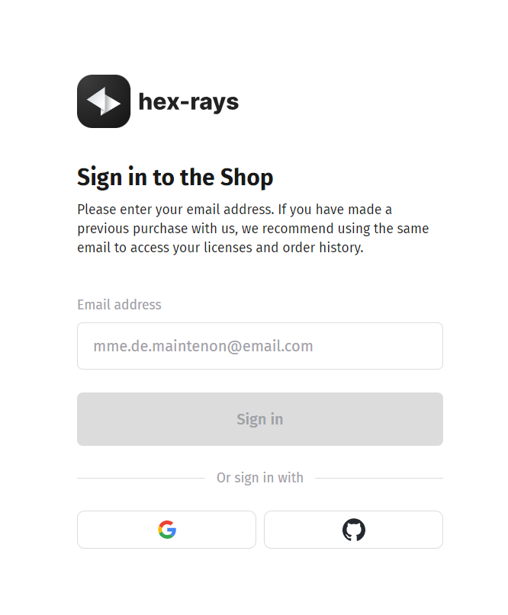
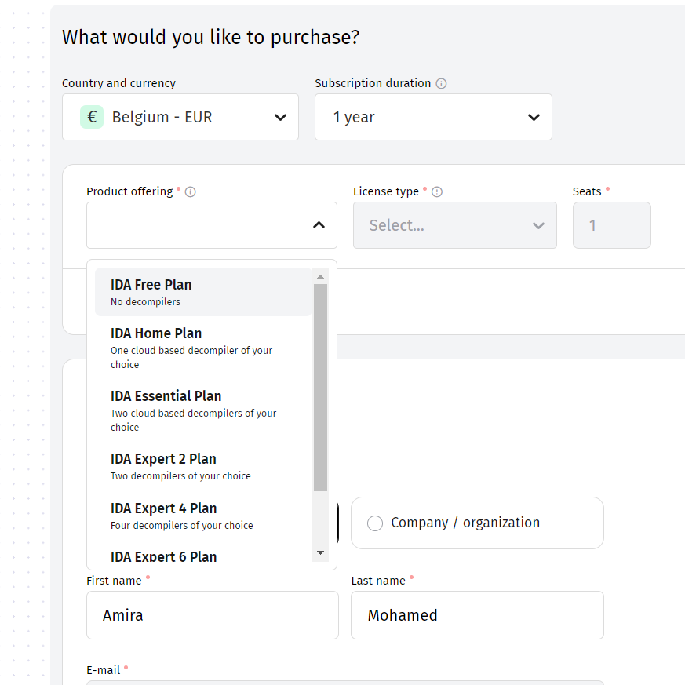
Add item , then select free plan

Slide 5
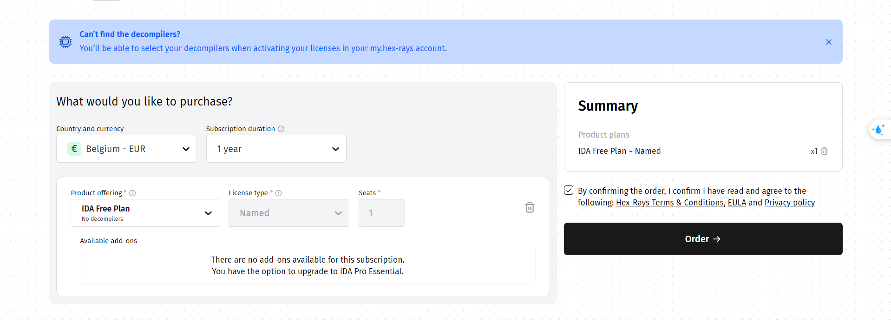
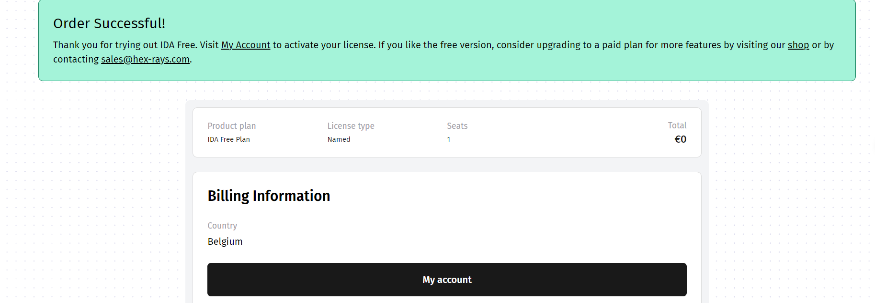

Slide 6
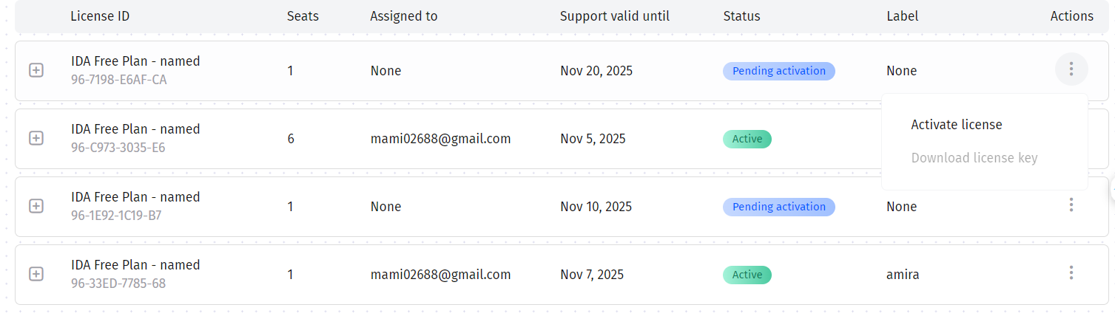
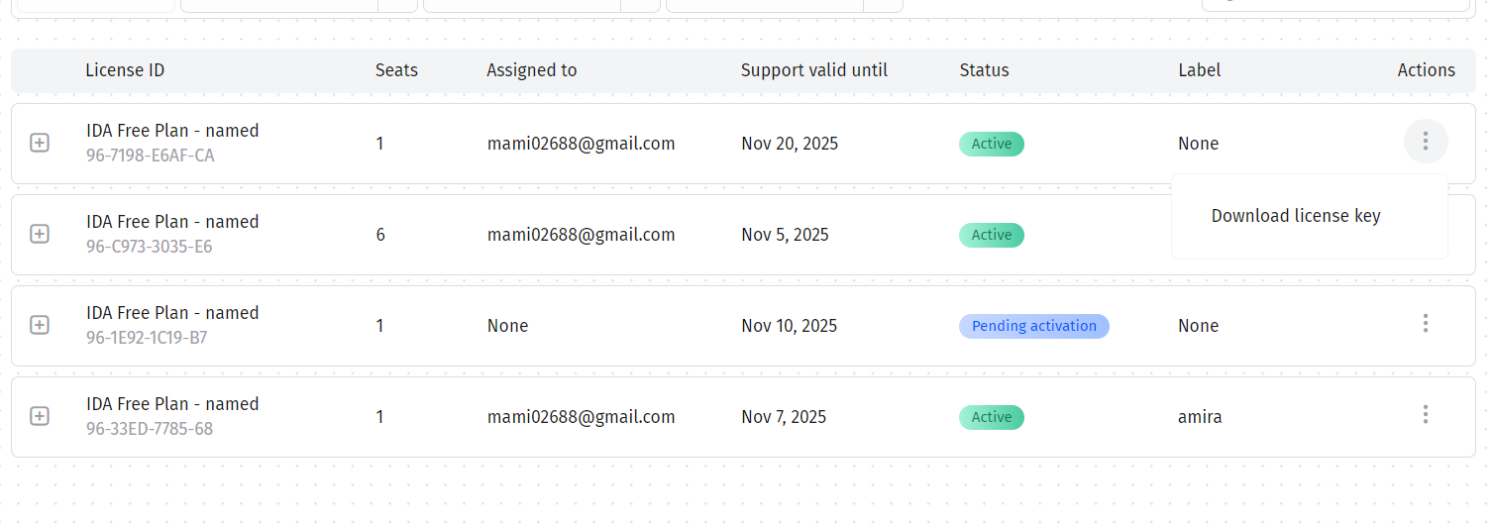
Licence Activation
Download License Key

Slide 7
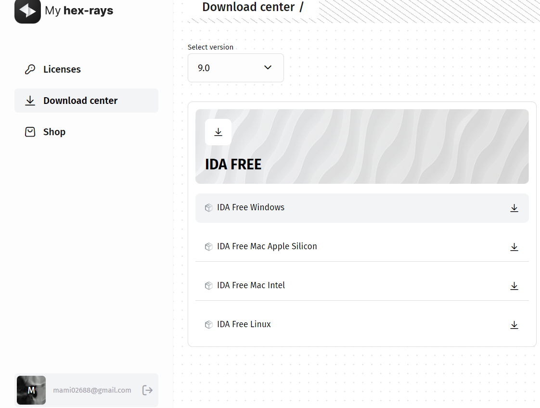

Slide 8
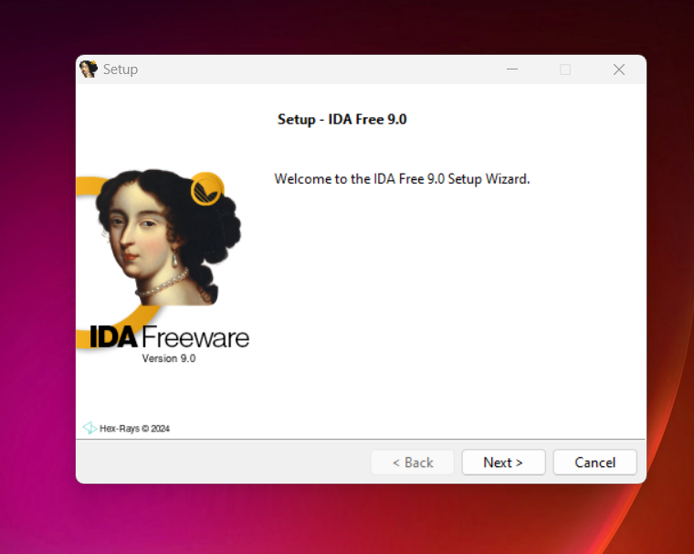
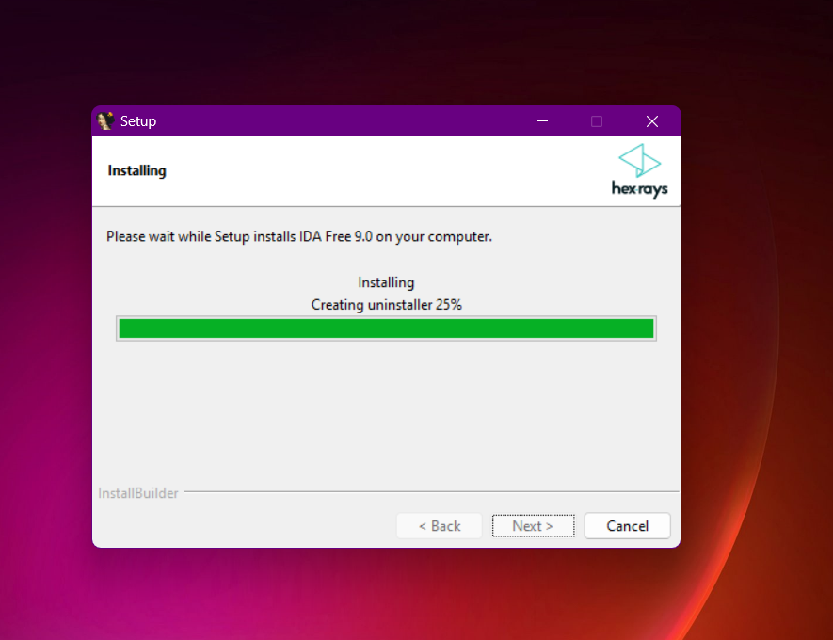
Now we have downloaded the program, let's start running

Slide 9
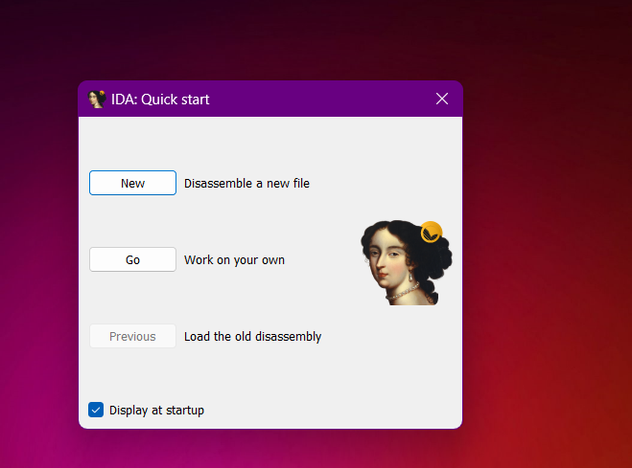
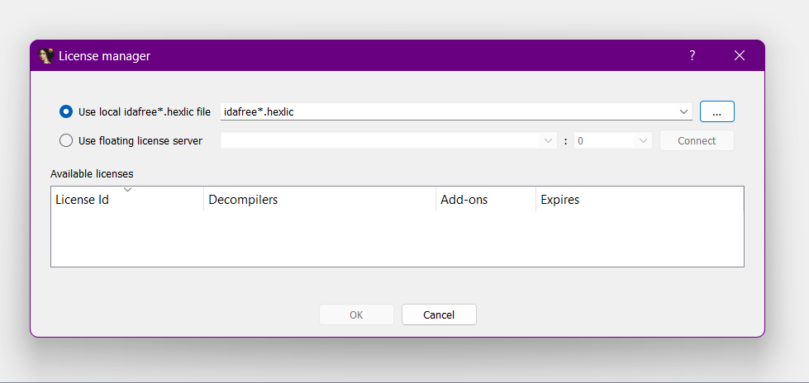
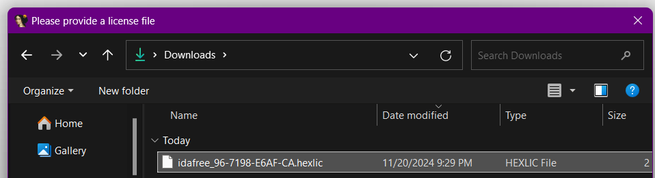
Now UpLoad License Key That We Downloaded,then Click OK

Slide 10
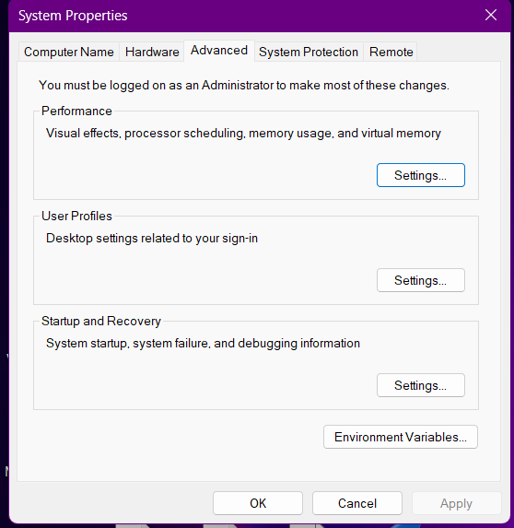
For our example we will Use a C compiler (such as MinGW or GCC) to convert the code into an executable file.
Download MinGW
https://sourceforge.net/projects/mingw-w64/
To set up and use MinGW as a compiler with IDA Free, you need to make sure that MinGW is installed correctly and that its path is added to your system's PATH. Here are the steps to run MinGW from the path it is in: The path of bin
Control Panel → System and Security → System → Advanced system settings → System Properties → Environment Variables

Slide 11
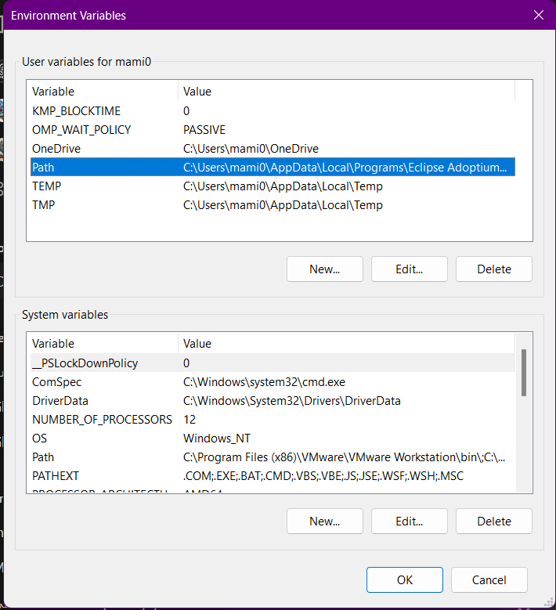
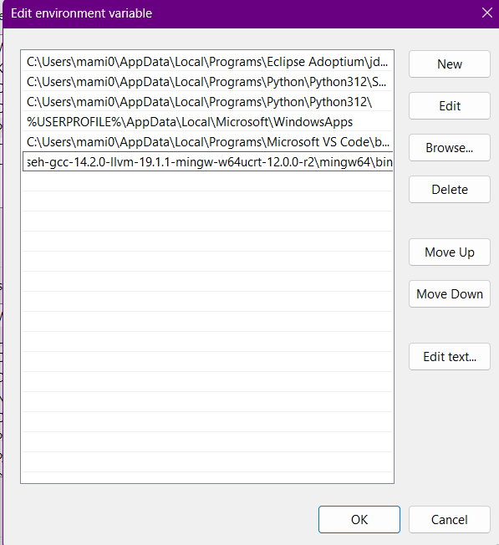

Slide 12

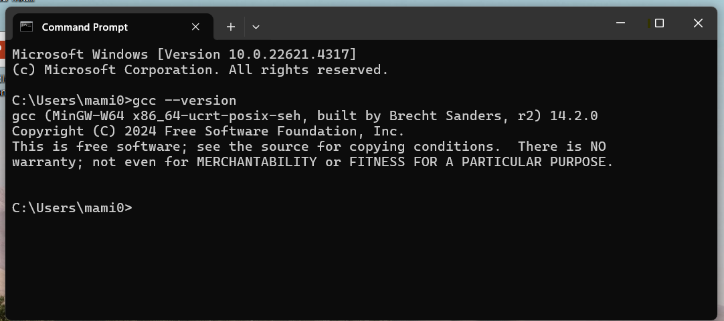
Verify installation
CMD→ gcc --version

Slide 13
Ghidra

Slide 14
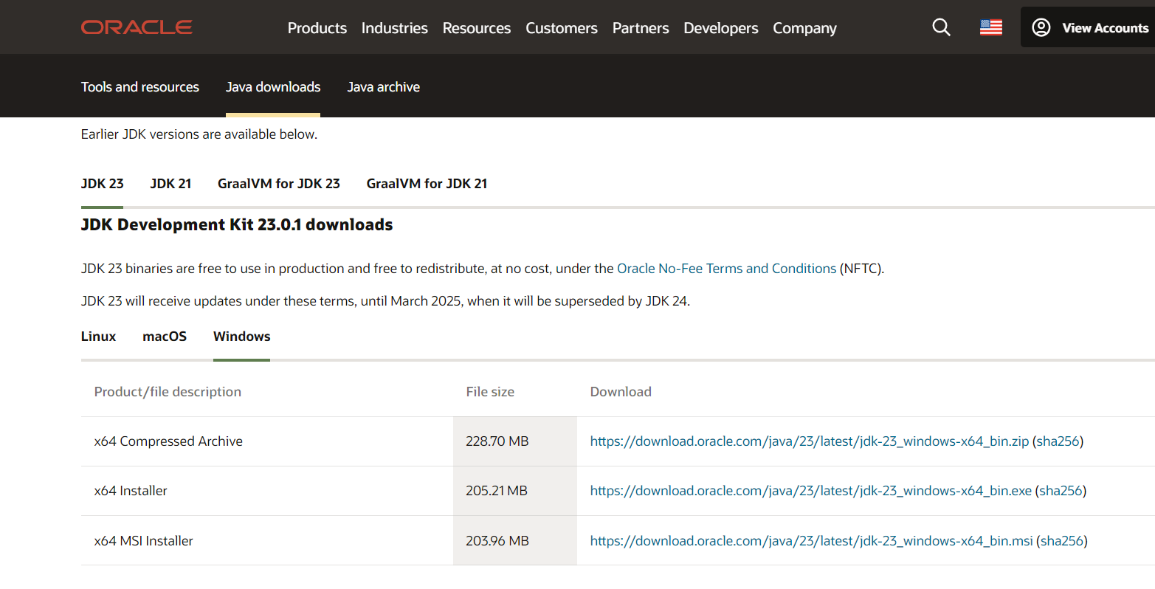
https://www.oracle.com/java/technologies/javase-downloads.html

Slide 15
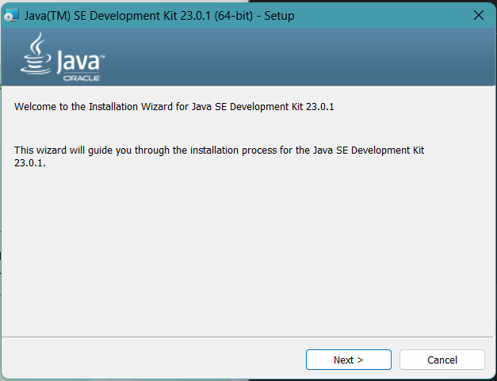
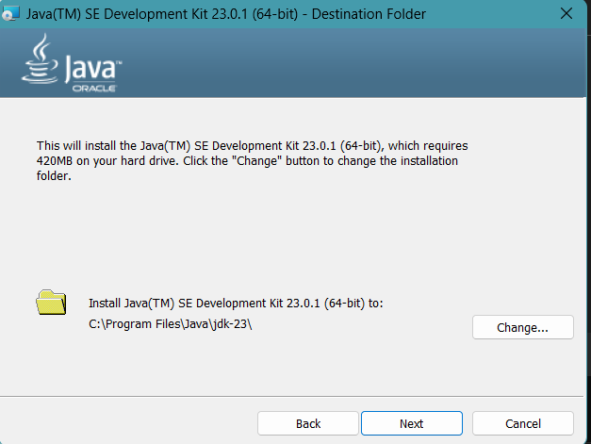
Copy path → C:\Program Files\Java\jdk-23

Slide 16
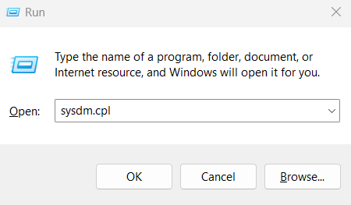
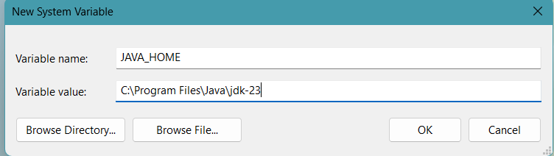
To set up the environment so that applications (such as Ghidra) recognize Java:
Win + R → write sysdm.cpl
1) Setting the JAVA_HOME environment variable
Advanced→Environment Variables→System Variables (New)→Variable Name= JAVA_HOME
→Variable Value=C:\Program Files\Java\jdk-23
2) Add the path to the Path variable:
Advanced→Environment Variables→ System Variables (path)→Edit→New→ C:\Program Files\Java\jdk-23\bin

Slide 17
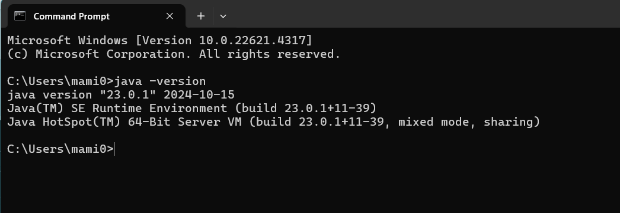
Verify installation
CMD→ java -version

Slide 18
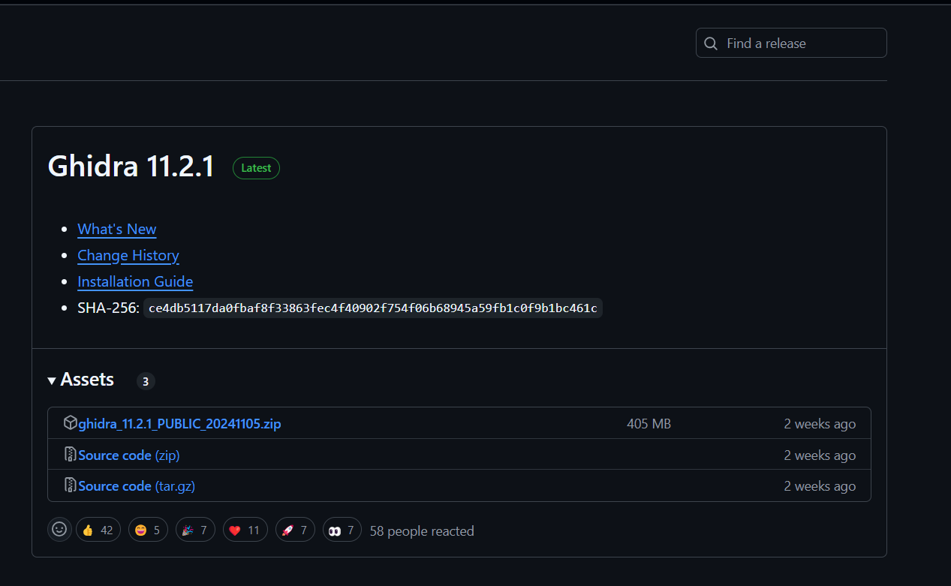
https://github.com/NationalSecurityAgency/ghidra/releases

Slide 19
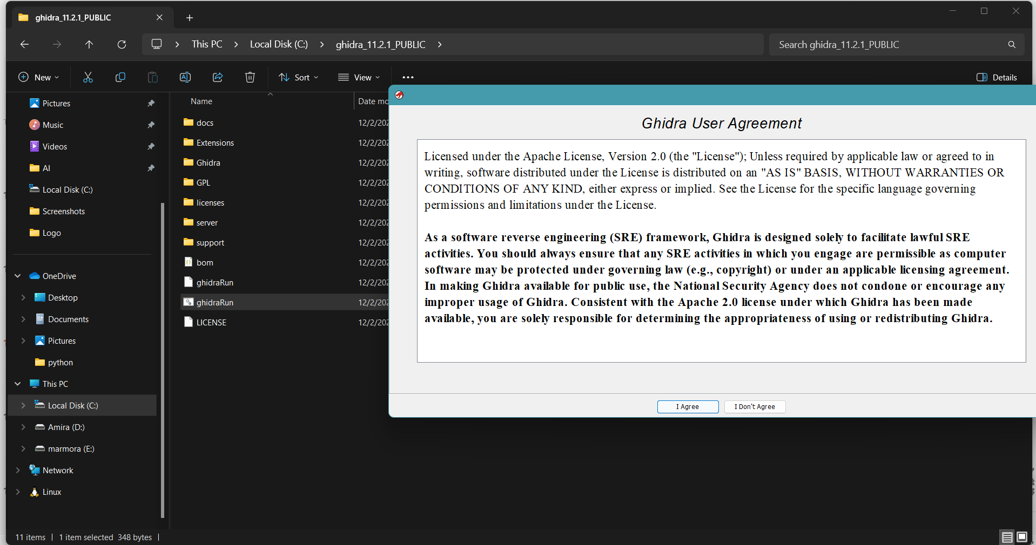
Unzip the Ghidra file→ ghidraRun

Slide 20
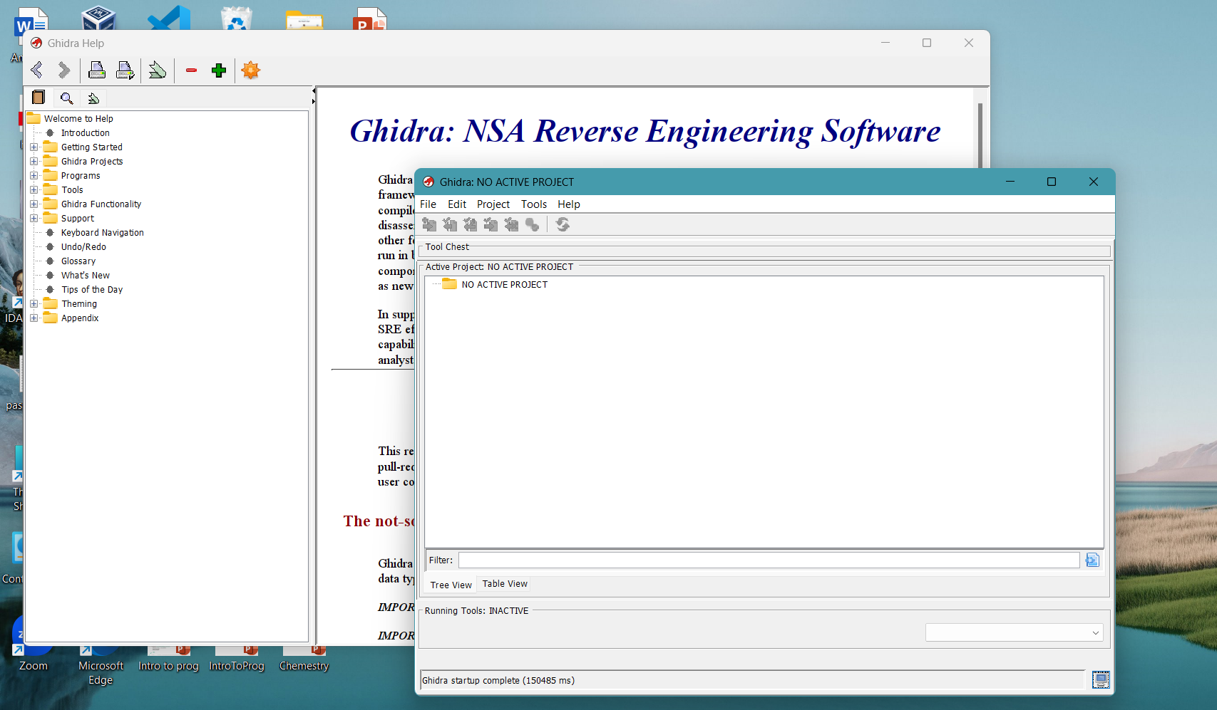

The Ghidra has been successfully downloaded..

